Slide 1
From cavemen to Kubernetes
An introduction to cloud VirTualization, containers, and Kubernetes

Slide 2
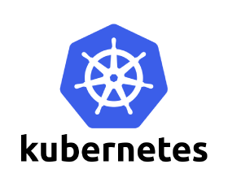
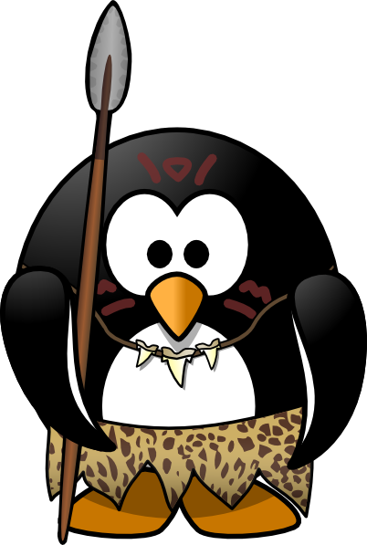

From cavemen to kubernetes
Bare metal servers
Cloud virtualization and VMs
Docker
Kubernetes

Slide 3
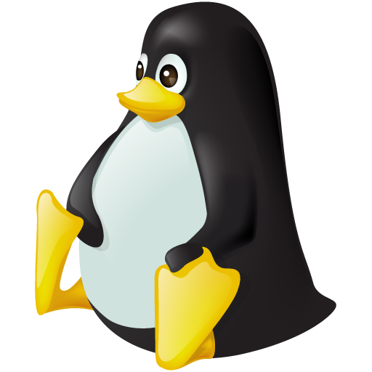
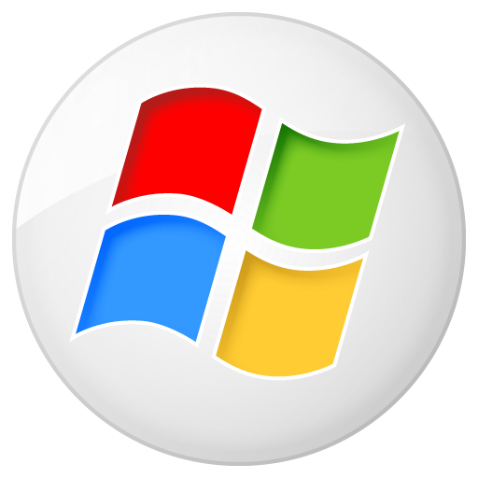
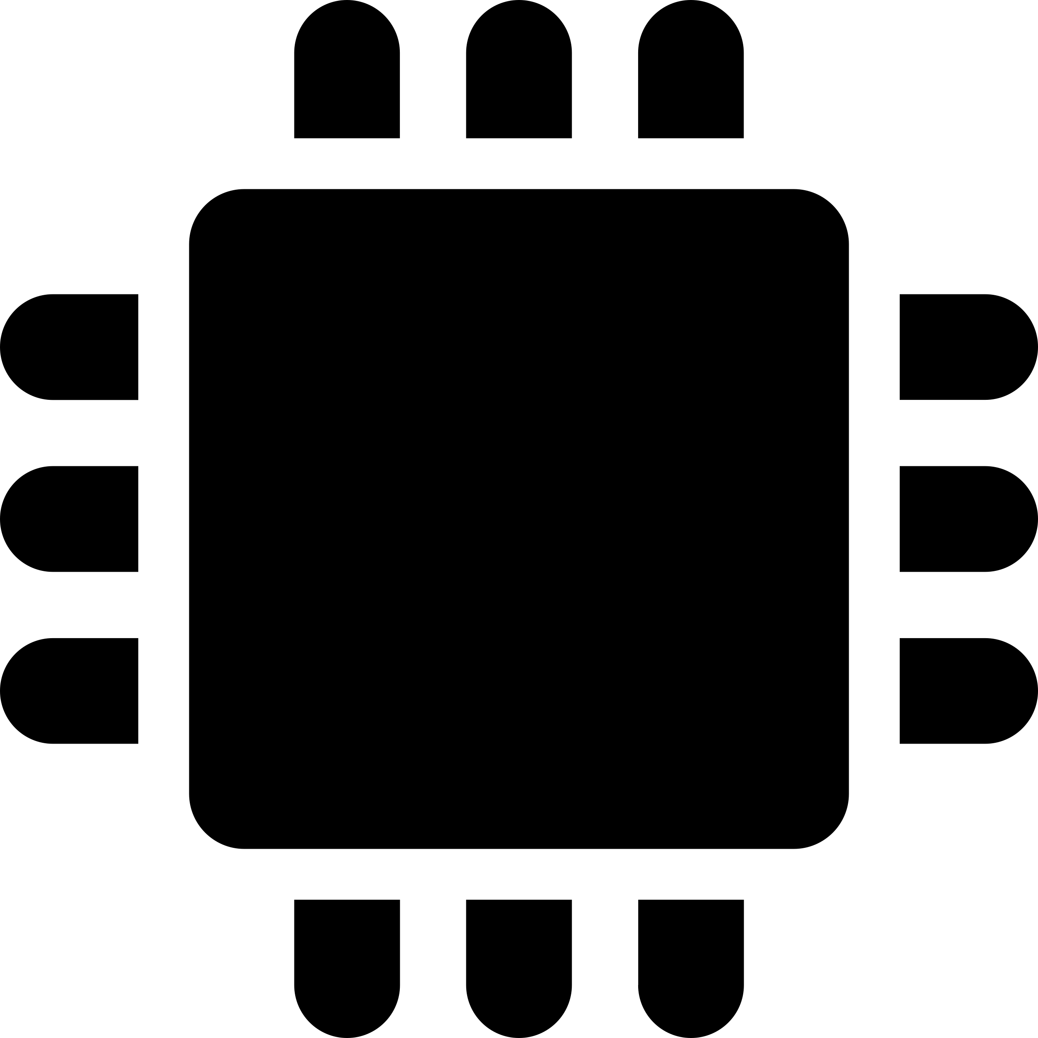
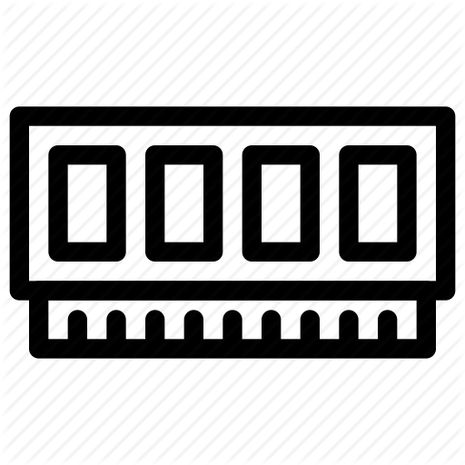
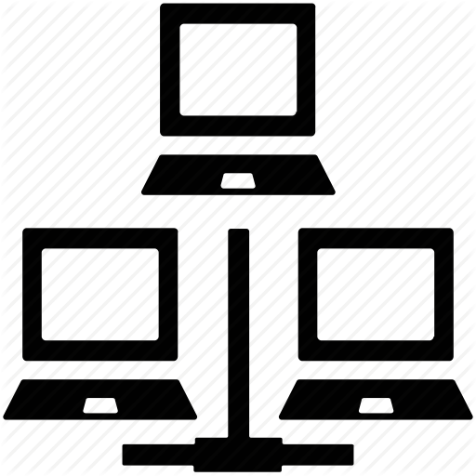
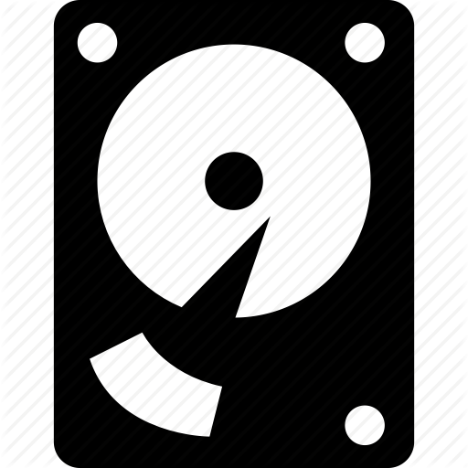
Bare metal Servers
Infrastructure
Operating System
Application
Application
Everything managed by owners and users
Hardware
Software
Security
Updates and Upgrades
Physical Location
Libraries

Slide 4
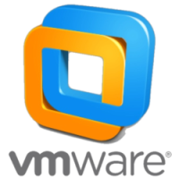
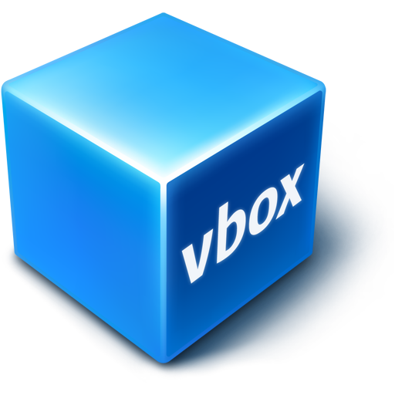
Virtualization
Infrastructure
Host Operating System
Virtualization Layer
Application
Guest OS
Virtual Machine
Application
Guest OS
Virtual Machine
Infrastructure can by maintained independent of the virtualized layer
Users are provisioned a VM
Dynamic resource scaling
Isolation
Users manage VM software
Located anywhere
Libraries
Libraries

Slide 5
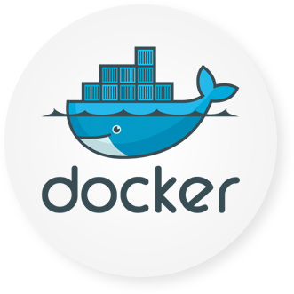
Docker
Infrastructure
Host Operating System
App
App
App
CONTAINER
CONTAINER
Docker is a computer program that performs operating-system-level virtualization also known as containerization. - Wikipedia
Aka the Docker engine
Containers share host infrastructure and resources
Containers are isolated from the host OS and each other
Libraries
Libraries
Notes:
Containers are not an actual “thing”, but collection of OS level tools

Slide 6
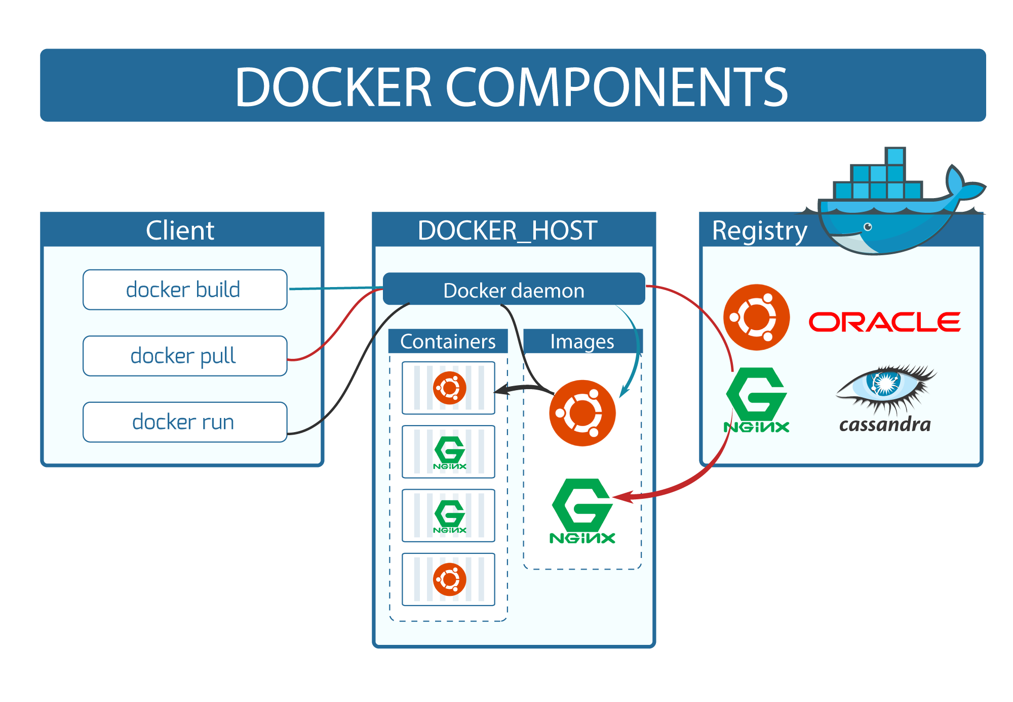

Slide 7
Kubernetes (k8s)
Kubernetes is an open-source container-orchestration system for automating deployment, scaling and management of containerized applications. It was originally designed by Google and is now maintained by the Cloud Native Computing Foundation. - Wikipedia
Notes:
3 THINGS - Scheduler, distributed key value pair, and API

Slide 8
The Cluster
Kubernetes coordinates a highly available cluster of computers that are connected to work as a single unit.
Kubernetes automates the distribution and scheduling of application containers across a cluster in a more efficient way.
Kubelet
Docker
Kubelet
Docker
Kubelet
Docker
Kubernetes cluster
Notes:
Declarative.
Underlying principle: declare a desired state, and k8s updates to match

Slide 9
The NODE
A node is a VM or a physical computer that serves as a worker machine in a Kubernetes cluster.
The Kubernetes node has the services necessary to run application containers and be managed from the master systems.
The Master is responsible for managing the cluster.
The nodes communicate with the master using the Kubernetes API
Kubelet
Docker
Kubelet
Docker
Node
Master
Kubelet
Docker
Node processes
Kubernetes cluster

Slide 10
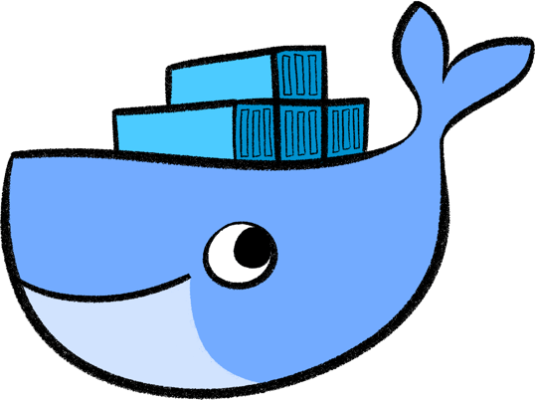
The POD
POD
Docker containers
Kubernetes provides Pods that can host multiple containers and storage volumes
A pod (as in a pod of whales or pea pod) is a group of one or more containers (such as Docker containers), with shared storage/network, and a specification for how to run the containers.
Pods are scheduled to run on any available node
POD
POD
Kubernetes node
Notes:
* Available node means it has adequte memory and CPU processing resources Pods

Slide 11
All together now
CLUSTER
USA
Clusters manage nodes
Nodes manage pods
Pods manage containers
Nodes can be spread across physical locations
Pods can be scheduled on any available node
NODE
POD
CONTAINER
CONTAINER
CHINA
Notes:
Nodes scale independently of the Pods/application layer

Slide 12
Developing in kubernetes
Pods are ephemeral
Applications are developed in containers
Dependencies are bundles with applications

Slide 13
DEMO
https://github.com/cscholze/cavemen-to-kuberenetes

Slide 14
Questions

